Slide 1


UNIVERSITY INSTITUTE OF ENGINEERING
Academic Unit V
Bachelor of Engineering
(Computer Science & Engineering)
Biology For Engineers
(23SZT-148)
Biology for Engineers
DISCOVER . LEARN . EMPOWER

Slide 2
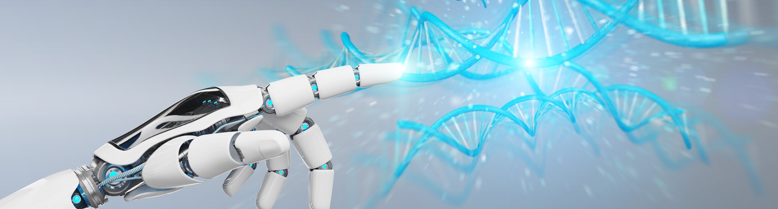
INTRODUCTION
Course Objective
This subject is designed to impart fundamental knowledge on basic of genetics and emerging fields of biology like biomedical recording system and medical instrumentation.
It is designed to impart knowledge that how to apply basics of biology in engineering.
https://www.uic.es/sites/default/files/uic-grau-bioenginyeria-hero-header_1.jpg
Biology for Engineers

Slide 3

INTRODUCTION
Course Outcome
Space for visual (size 24)
CO Number | Title | Level
CO1 | Identify the biological concepts from an engineering perspective. | knowledge
CO2 | Development of artificial systems mimicking human action. | Understand
CO3 | Explain the basic of genetics that helps to identify and formulate problems | Analyze
CO4 | Apply knowledge of measurement system, biomedical recording system and biosensors to excel in areas such as entrepreneurship, medicine, government, and education. | Apply
CO5 | Integrate biological principles for developing next generation technologies, | Create
Will be covered in this lecture
https://specials-images.forbesimg.com/imageserve/1034901762/960x0.jpg?fit=scale
Biology for Engineers

Slide 4

Unit-1 | Importance of Biology In Engineering | Contact Hours: 15
Chapter 1 Significance of Biology in Engineering Chapter 2 Genetics | Introduction: Fundamental Differences between Science and engineering by drawing a comparison between eye and camera, Bird flying and aircraft. Significance of Biology in Engineering, Discuss how biological observations of 18th Century that lead to major discoveries, Examples from Brownian motion and the origin of thermodynamics by referring to the original observation of Robert and Julius Mayor. Genetics: Mendel’s laws, Concept of segregation and independent assortment, concept of allele, gene mapping, Gene interaction, Epitasis, Meiosis and Mitosis as a part of genetics. Mechanism of how genetic material passes from parent to offspring. Concepts of recessiveness and dominance. Concept of mapping of phenotype to Genes, single gene disorders in humans, concept of complementation using human genetics.
Biology for Engineers

Slide 5


Slide 6

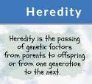
What is genetics?
  “Genetics is the study of heredity, the process in which a parent passes certain genes onto their children.”
  Children inherit (belonging to the nature of a person or thing) their biological parents’ genes that express specific traits, such as some physical characteristics, natural talents, and genetic disorders.
Biology for Engineers
Notes:
Conduct a brief class discussion to assess students’ knowledge and assumptions about genetics, while providing the information to those students who may not have any prior knowledge.

Slide 7

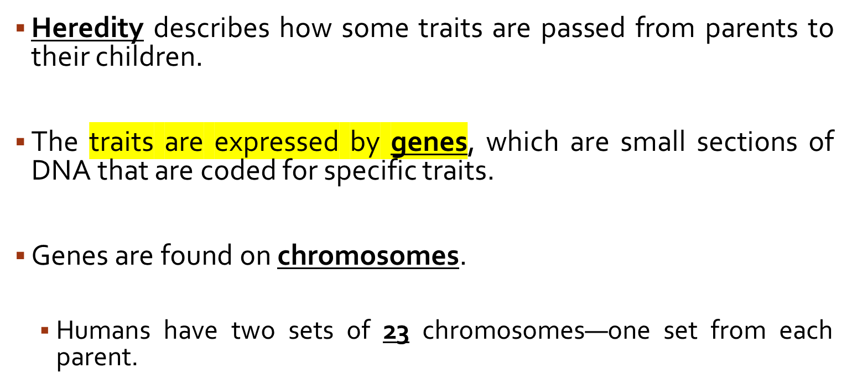
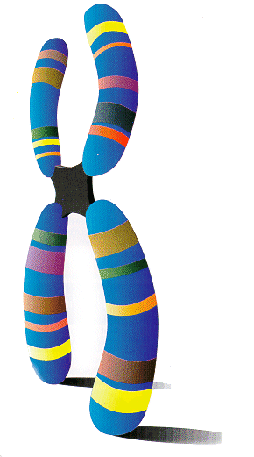
Biology for Engineers
Notes:
Have students volunteer their answers, and help students understand that the inherited traits are passed from one generation to the next as the parents’ chromosomes are copied and passed to their children.

Slide 8
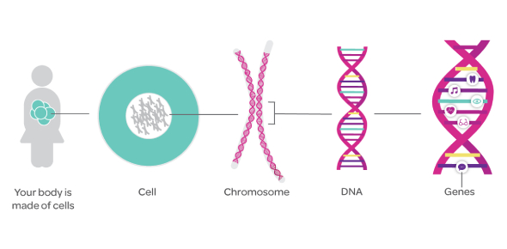
A gene is instruction code
The smallest, basic unit of life that is responsible for all of life’s processes.
Threadlike structures made of protein and DNA that serve to carry the genomic information from cell to cell.
Deoxyribonucleic acid is the molecule that carries genetic information
A gene is the basic physical and functional unit of heredity. Genes are made up of DNA.

Slide 9
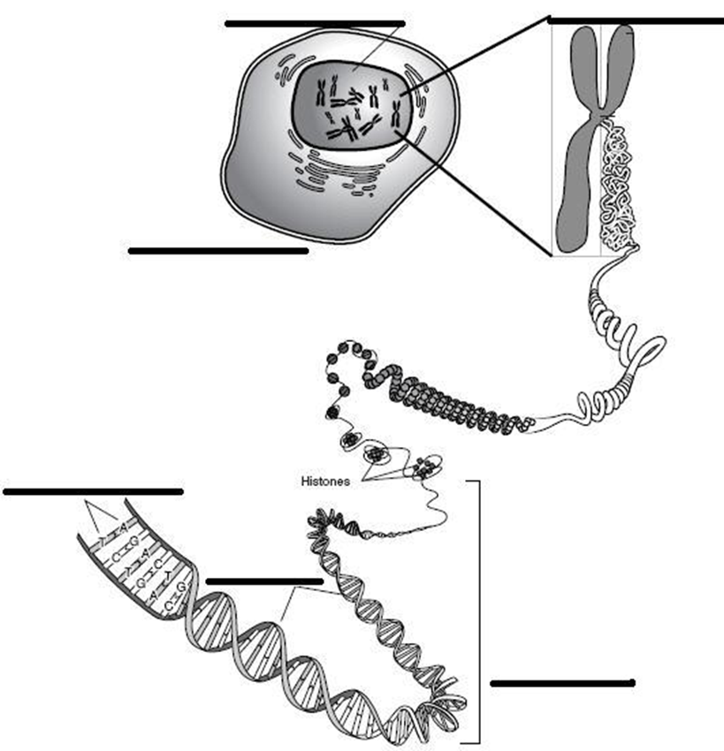
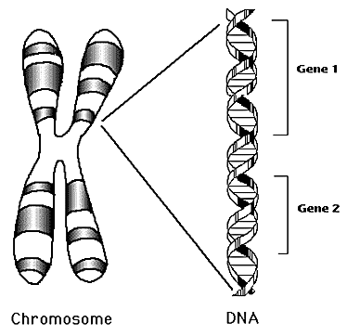
Nucleus
Chromosome
Cell
Nucleotides
Genes
DNA

Slide 10
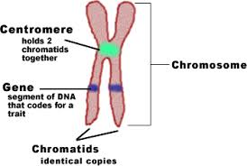
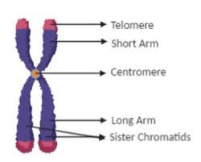
Biology for Engineers

Slide 11

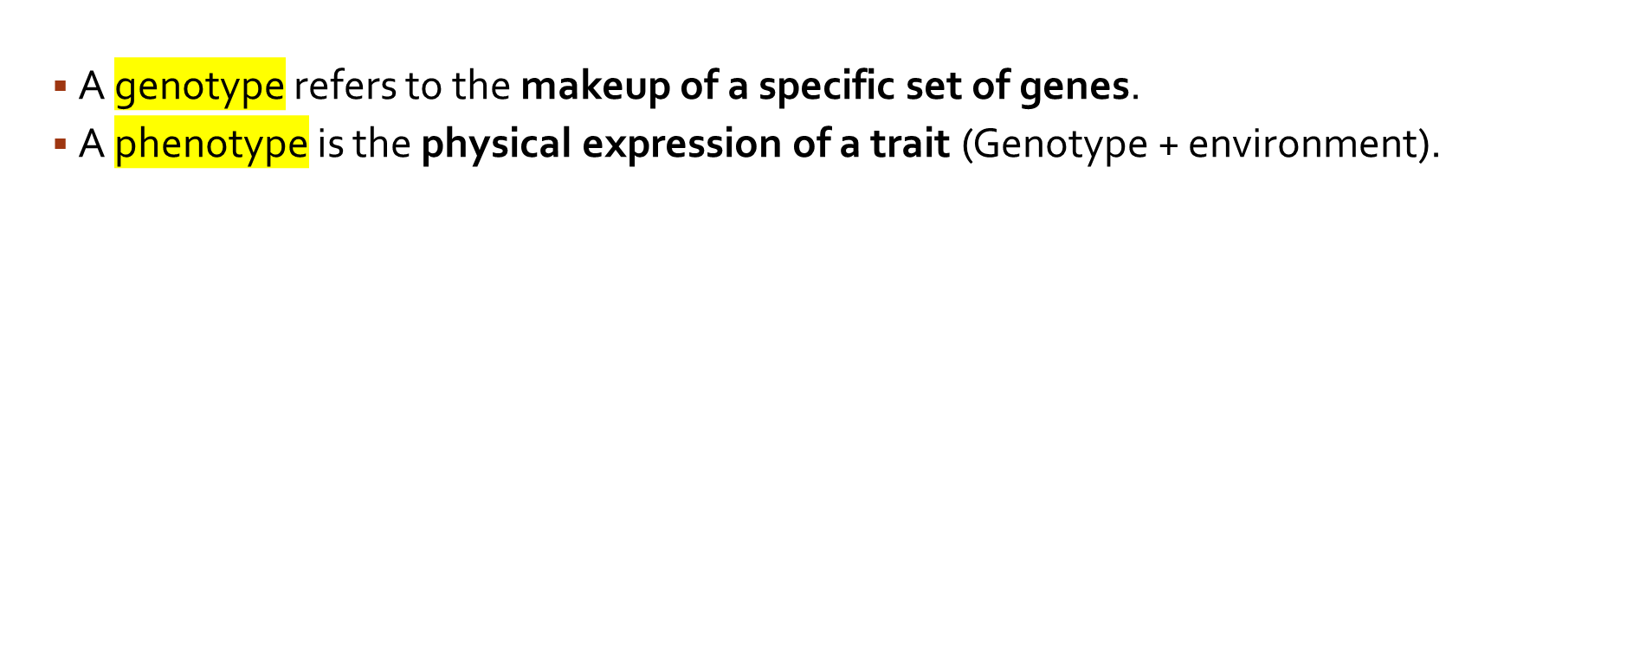
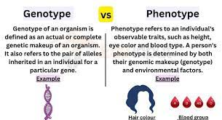

Slide 12
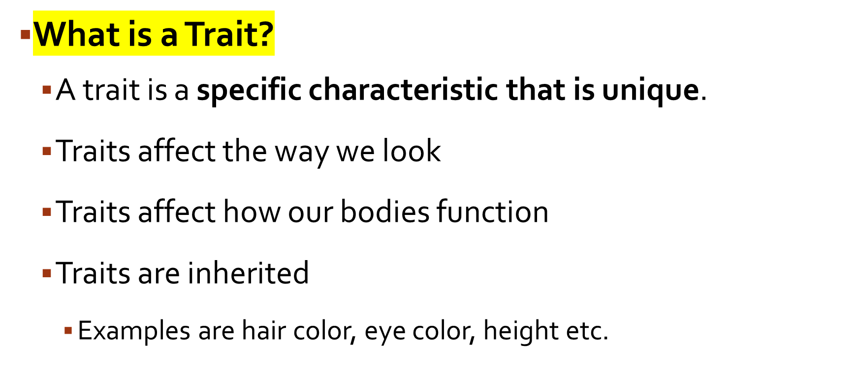
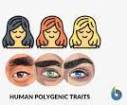

Slide 13
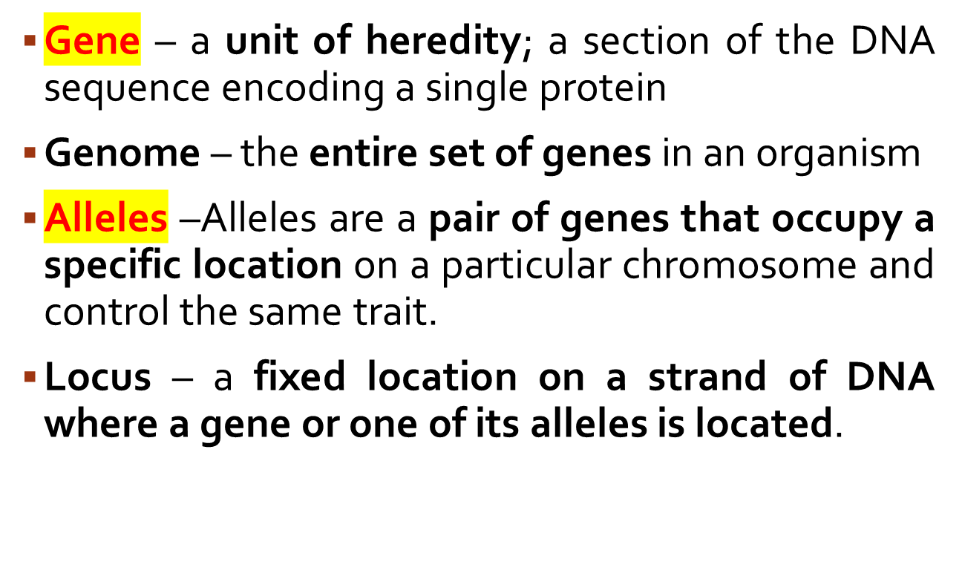
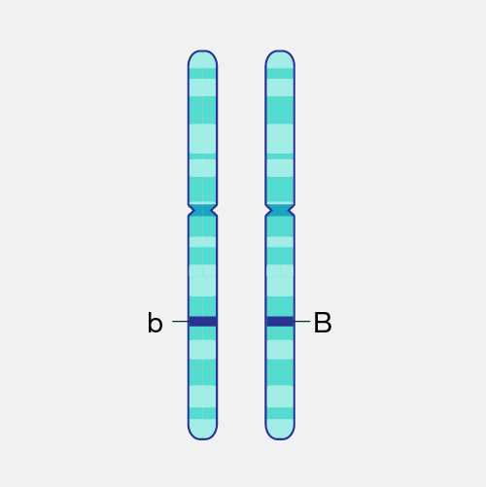
Biology for Engineers

Slide 14
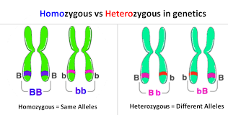
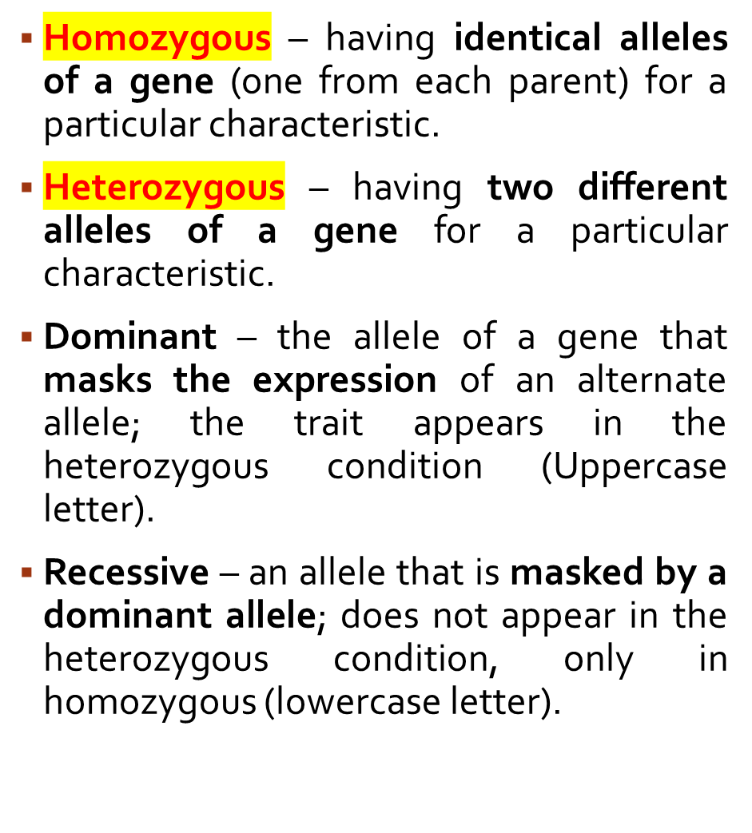
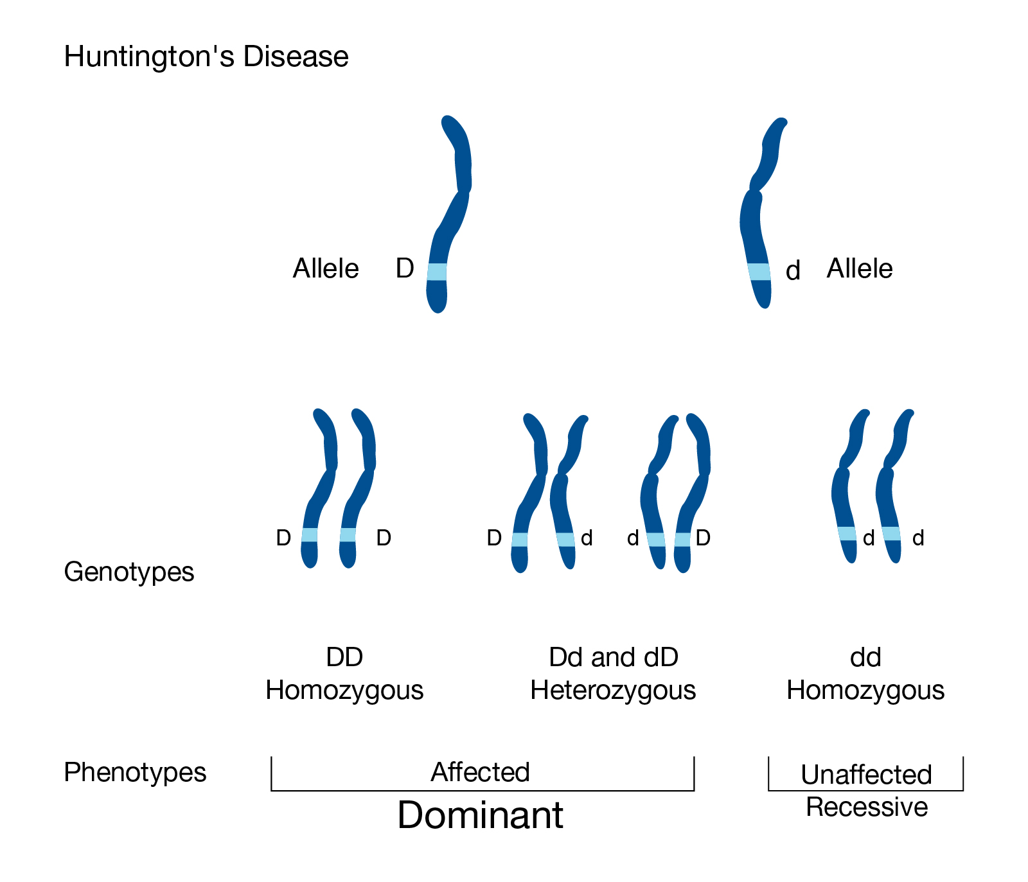
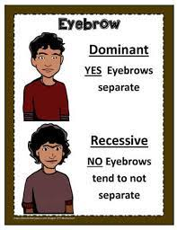
Biology for Engineers

Slide 15
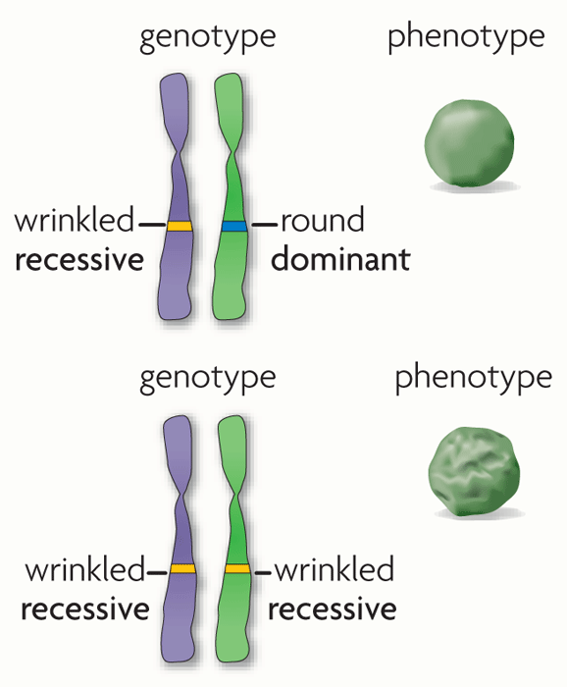
r
R
r
r

Slide 16

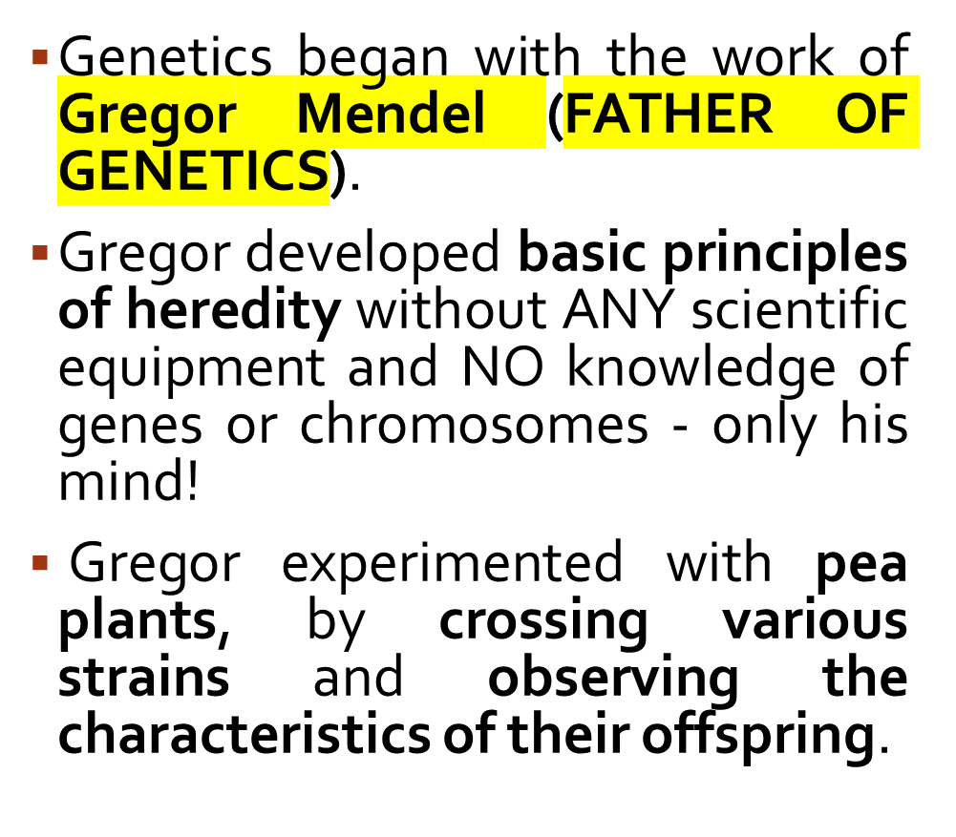
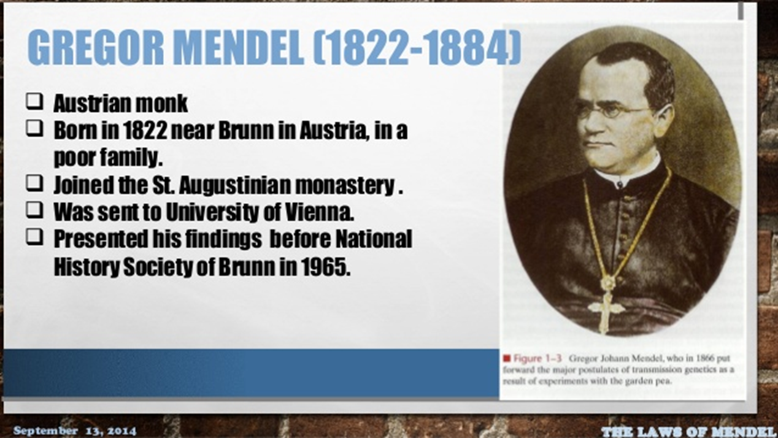
Biology for Engineers

Slide 17

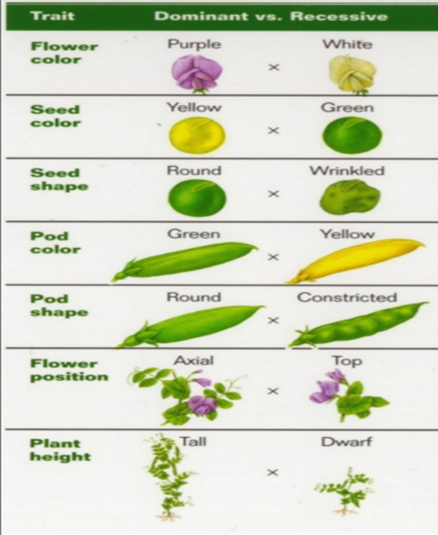
Mendel looked at seven traits or characteristics of pea plants:
Biology for Engineers

Slide 18

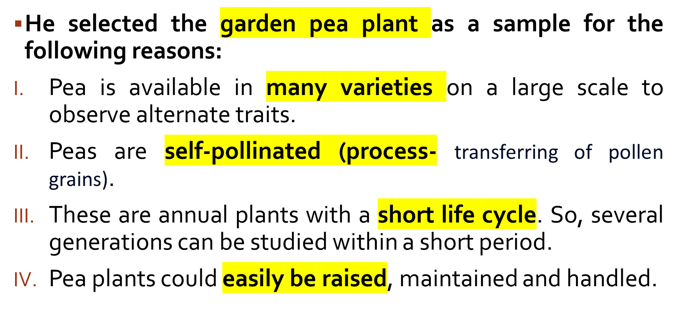

Slide 19
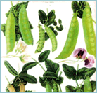
Mendel was the first biologist to use Mathematics – to explain his results quantitatively.
Mendel predicted
The concept of genes
That genes occur in pairs
That one gene of each pair is present in the gametes
Biology for Engineers

Slide 20

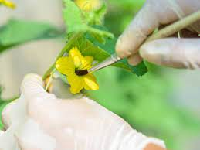
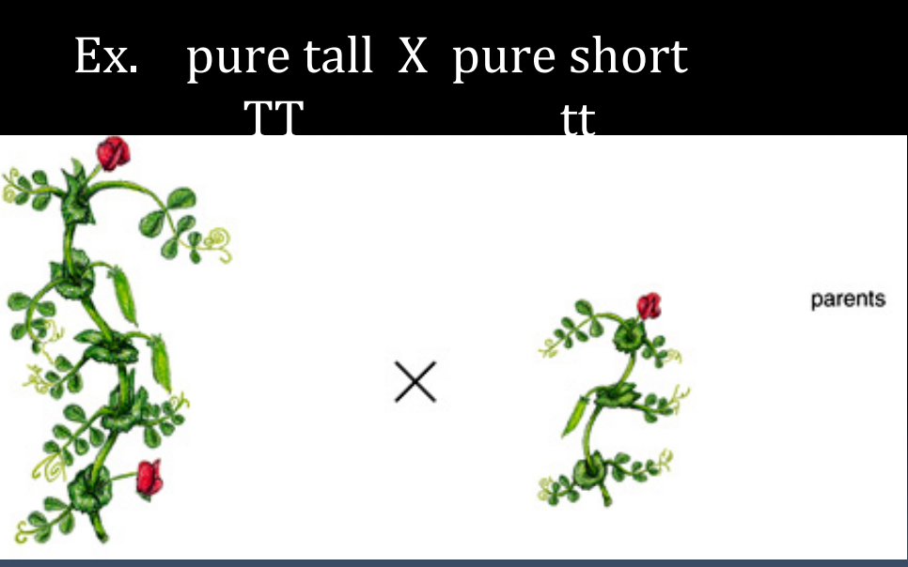
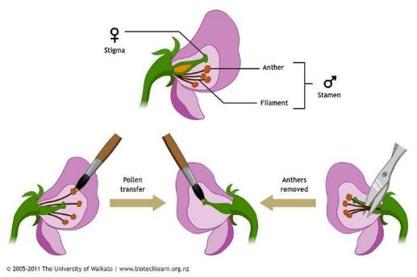
Mendel began by cross-pollinating pure plants with contrasting traits
Biology for Engineers

Slide 21
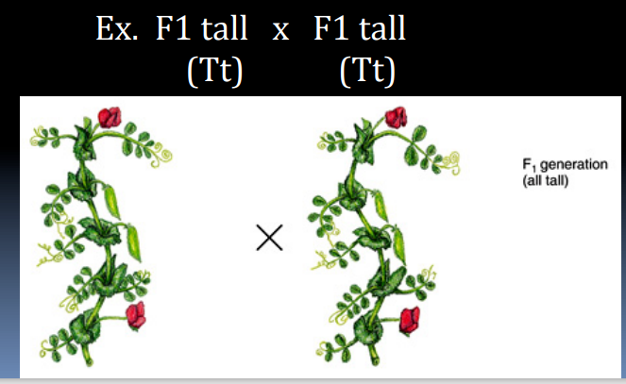
Mendel then used two of these F1 tall plants and crossed them.
Mendel then observed the offspring or 1st Filial generation (F1), and noticed only one trait (they were all tall)
Biology for Engineers

Slide 22
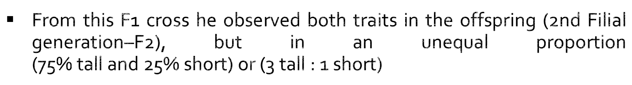
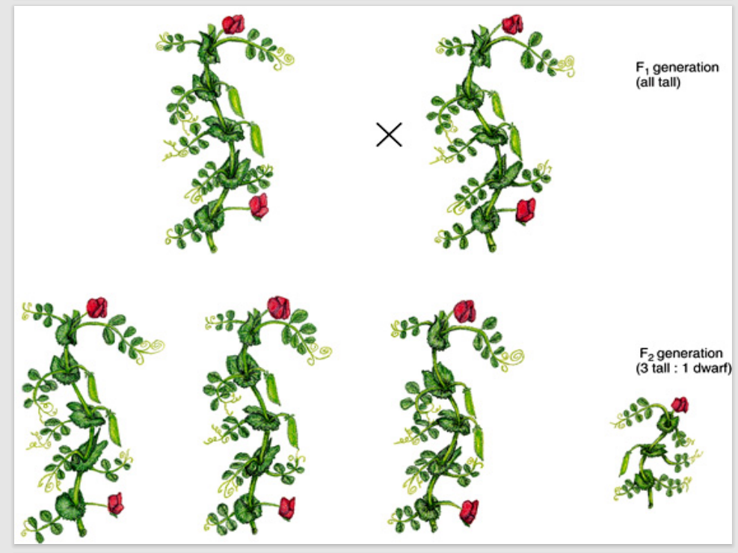
Biology for Engineers

Slide 23
Mendel determined that one form of the trait is dominant over the other recessive trait (Tall is dominant over short)
Parents | pure tall | X | pure short
F1 | all tall
F2 | 3 tall | : | 1 short
Biology for Engineers

Slide 24
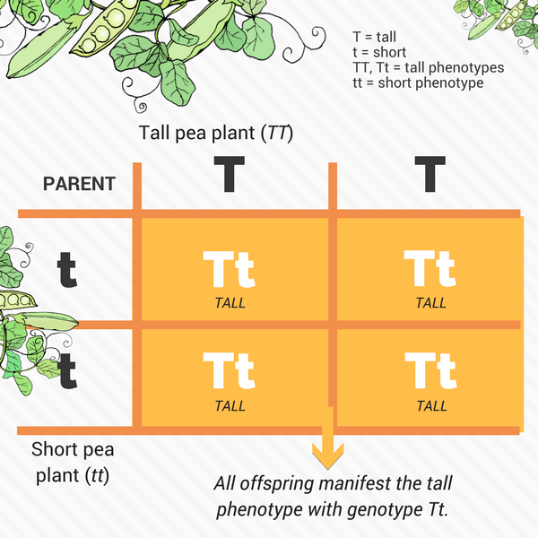
Dominant alleles always mask the recessive alleles
Only one parental character expresses itself in the F1 generation while both are expressed in F2 generation.
Biology for Engineers

Slide 25


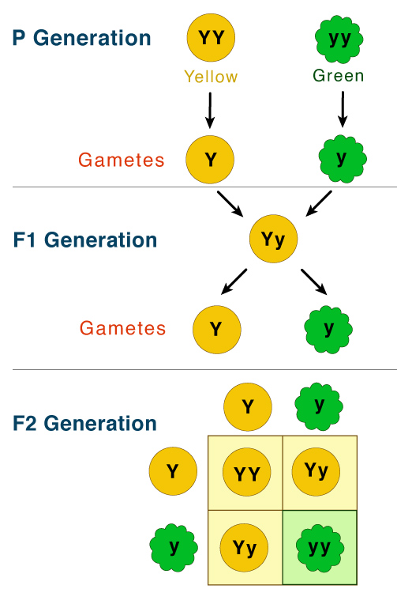

According to this law parents contain two alleles during gamete formation, the factors or alleles of pair segregate from each other such that a gamete receives only one of the two factors.
Two copies of each factor separate and each parent offspring attain one factor.
Biology for Engineers
Gamete- Reproductive cell

Slide 26
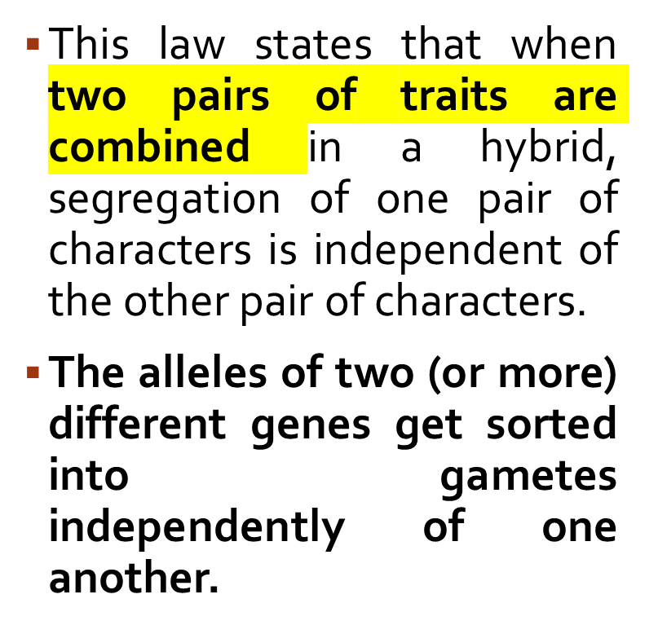
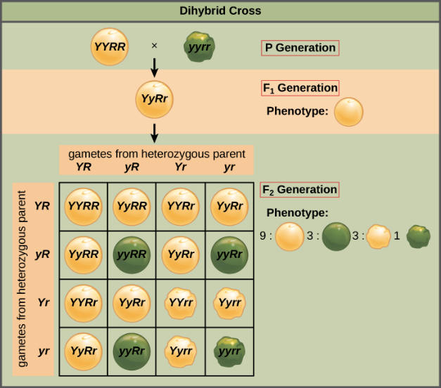


Slide 27
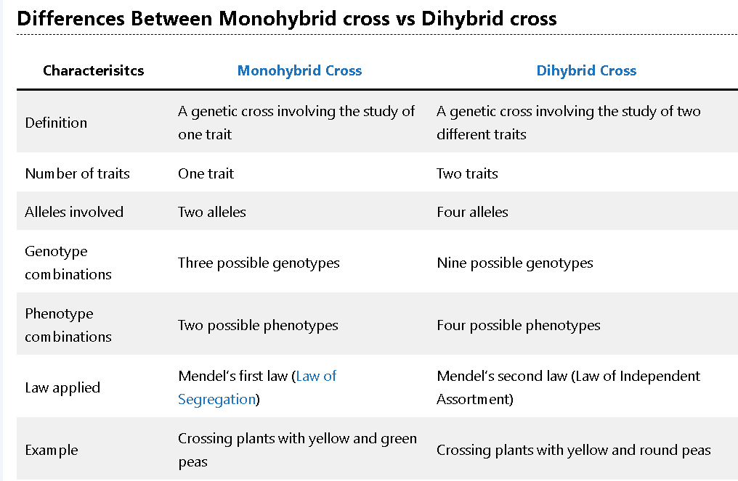

Biology for Engineers

Slide 28



Biology for Engineers

Slide 29

Gupta, P.K.. Cytology, Genetics and Molecular Biology, Rastogi Publishers, Meerut, 1993.
Roit I.M., Brostoff J. and Male D. Mosby .Immunology (6 th Edition) by, An imprint of Elsevier Sci Ltd., 2002.
https://www.youtube.com/watch?v=wv1TQXBQ6wQ
https://www.youtube.com/watch?v=zNEtVaNQ0s8
(http://www.nlm.nih.gov/medlineplus/ency/article/002048.htm)
https://nptel.ac.in/courses/121/106/121106008/
https://www.utoledo.edu/engineering/bioengineering/undergrad/prospective/whatisbioe.html#:~:text=Bioengineering%20is%20the%20application%20of,health%20care%20and%20other%20fields.
https://i.pinimg.com/originals/68/c9/30/68c930e95113ceb2e3dfc9de2f164680.png
https://youtu.be/FBUpnG1G4yQ
Biology for Engineers
<number>/10

Slide 30

THANK YOU
Biology for Engineers

